Slide 1
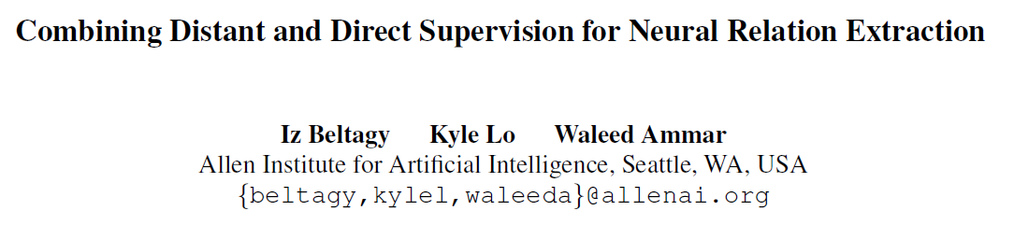
NAACL 2019

Slide 2
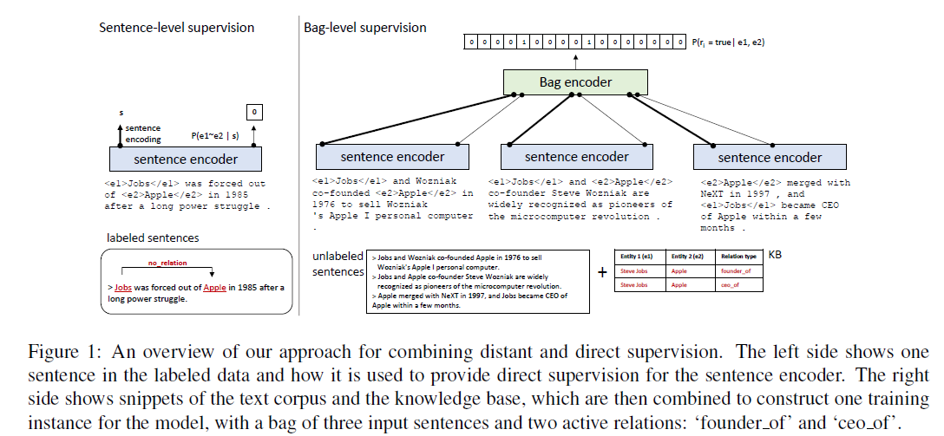
Method

Slide 3
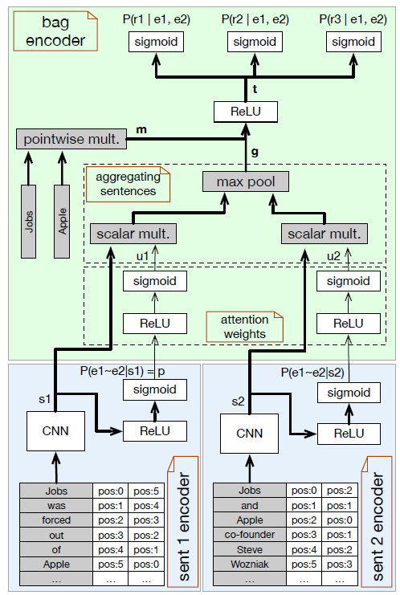
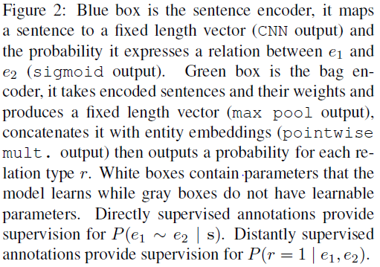
Model

Slide 4

Sigmoid+Maxpool
Bag representation：

Slide 5



Loss function
“This supervision serves two purposes: it improves our encoding of each sentence, and improves the weights used by the attention to decide which sentences should contribute more to the bag encoding. It also has the side benefit of not requiring the same set of relation types as that of the distant supervision data, because we only care about if there exists some relevant relation or not between the entities.”
Distant Supervision Loss:
Direct Supervision Loss:
Combination:

Slide 6
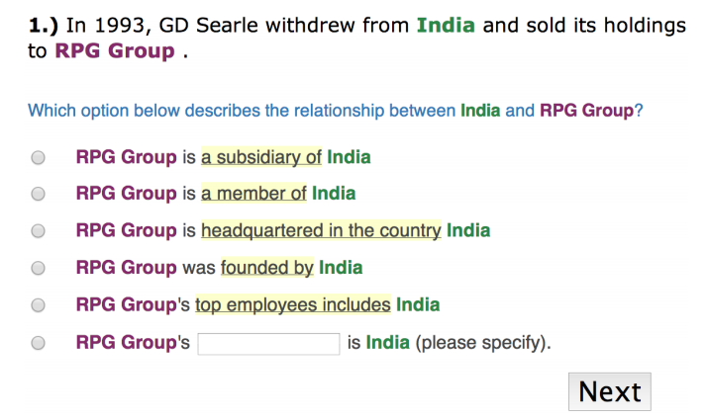
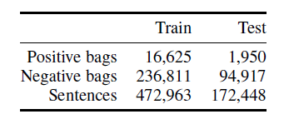
Data
Distant Supervision Data:
Direct Supervision Loss:
“It has 22,766 positive examples for 41 relation types in addition to 11,049 negative examples.”
Combining Distant and Partial Supervision for Relation Extraction. Gabor Angeli, Julie Tibshirani, Jean Y. Wu, Christopher D. Manning. EMNLP2014

Slide 7
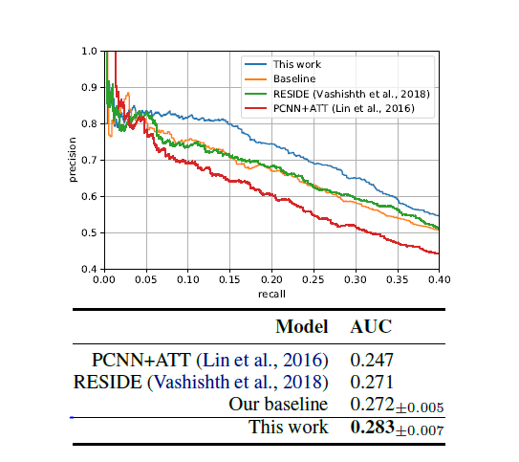
Result

Slide 8
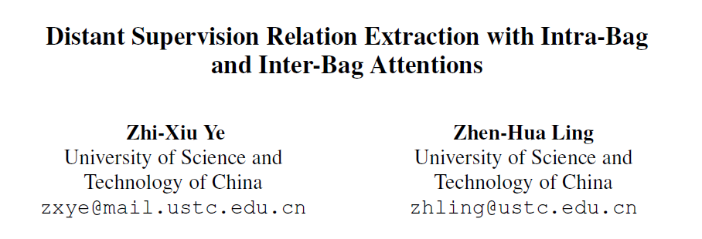
NAACL 2019

Slide 9
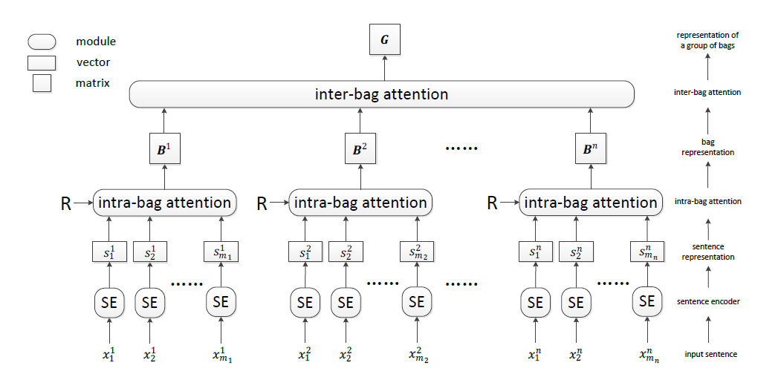
Model

Slide 10

Differences
Relation-aware:
Inter-Bag Attention:

Slide 11




Inter-Bag Attention:
Bag representation:
k-th relation weight:
k-th relation score:
“Inspired by the self-attention algorithm”

Slide 12
Pre-training Strategy
“We first train the model with only intra-bag attentions until convergence. Then, the inter-bag attention module is added and the model parameters are further updated until convergence again.”

Slide 13
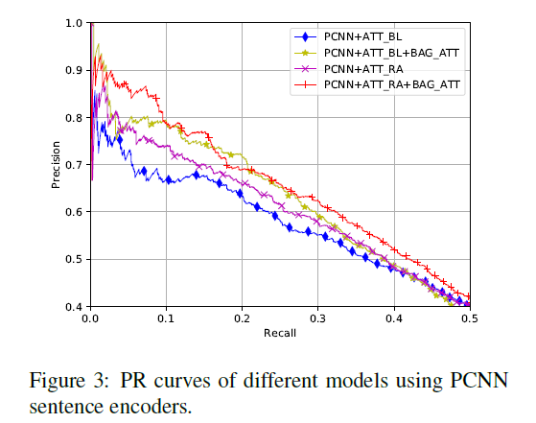
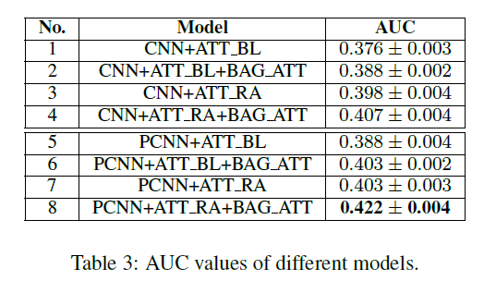
Result

Slide 14
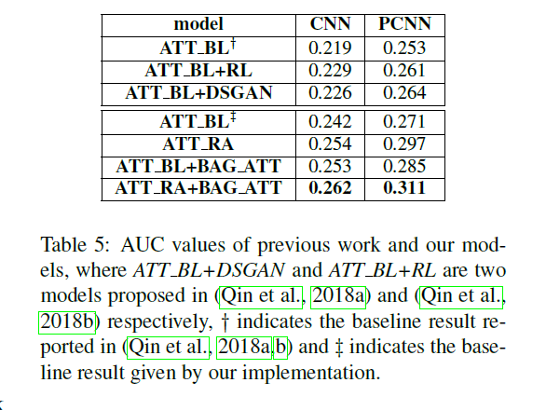
Result

Slide 15
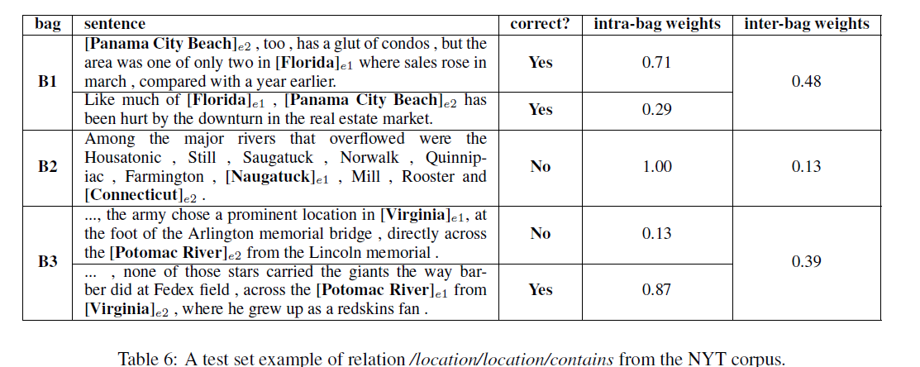
Case study

